Slide 1
Machine Learning & Deep Learning
Week-9
Instructor: Najam Aziz

Slide 2
Naive Bayes Classifier

Slide 3
Natural Phenomena
Deterministic:A deterministic model does not include elements of randomness. Every time you run the model with the same initial conditions you will get the same results.
Most simple mathematical models of everyday situations are deterministic
Probabilistic:A probabilistic model includes elements of randomness. Every time you run the model, you are likely to get different results, even with the same initial conditions. A probabilistic model is one which incorporates some aspect of random variation.
--Deterministic models can be relatively simple and can be used when random variation is not a major influence on the situation being modelled (random variation is relatively small). If random variation is a major component of the context, a probabilistic model may be needed to fit the purpose.

Slide 4
Probability
Probability = Mathematics of Chance - Quantification of Uncertainty - How likely something is to happen.
The word probability was used in relation to the mathematics of chance in 1662
We use probability in daily life to make our decisions when we aren’t sure about what the outcome will be.
Many events can't be predicted with total certainty. The best we can say is how likely they are to happen, using the idea of probability.
Tossing a coin
Throwing a dice
Probability does not tell us exactly what will happen, it is just a guide/educated guess

Slide 5
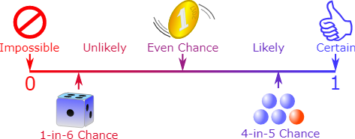
Probability is always between 0 and 1

Slide 6
Some Terminologies
Experiment: a repeatable procedure with a set of possible results.
Event: one or more outcomes of an experiment. The toss of a coin, throw of a dice and lottery draws are all examples of random events.
Events can be:
Independent (each event is not affected by other events),
Dependent (also called "Conditional", where an event is affected by other events)
Mutually Exclusive (events can't happen at the same time)
Complement of an Event: All outcomes that are NOT the event. P(A) + P(A') = 1
Random Variable: set of possible values from a random experiment. Random Variables can be either Discrete or Continuous.
Sample Space: all the possible outcomes of an experiment.

Slide 7
Joint, Marginal & Conditional Probability
Joint probability: p(A and B). The probability of event A and event B occurring. It is the probability of the intersection of two or more events. The probability of the intersection of A and B may be written p(A ∩ B). Example: the probability that a card is a four and red =p(four and red) = 2/52=1/26. (There are two red fours in a deck of 52, the 4 of hearts and the 4 of diamonds).
Marginal probability: the probability of an event occurring (p(A)), it may be thought of as an unconditional probability. It is not conditioned on another event. Example: the probability that a card drawn is red (p(red) = 0.5). Another example: the probability that a card drawn is a 4 (p(four)=1/13).
Conditional probability: p(A|B) is the probability of event A occurring, given that event B occurs. Example: given that you drew a red card, what’s the probability that it’s a four (p(four|red))=2/26=1/13. So out of the 26 red cards (given a red card), there are two fours so 2/26=1/13.

Slide 8
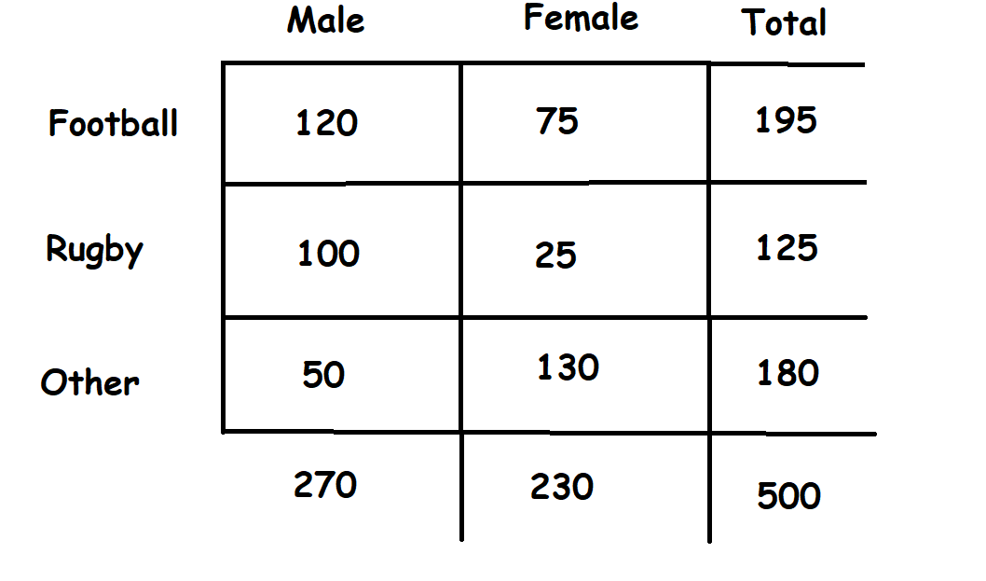
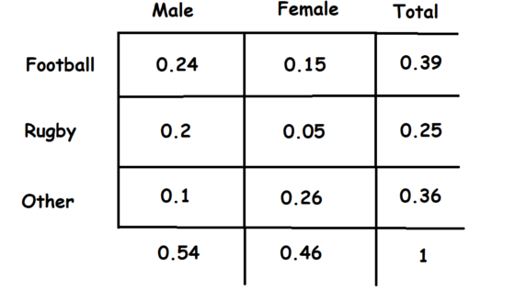
Joint, Marginal & Conditional Probability
A survey was carried out with 500 strangers to determine people’s favorite sports.

Slide 9
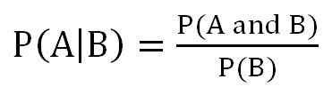
How to Manipulate among Joint, Conditional and Marginal Probabilities
The equation below is a means to manipulate among joint, conditional and marginal probabilities. As you can see in the equation, the conditional probability of A given B is equal to the joint probability of A and B divided by the marginal of B.

Slide 10

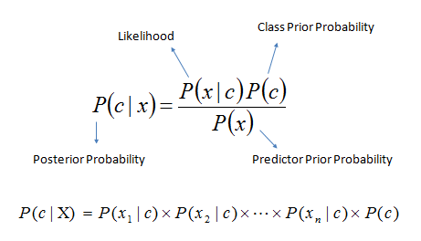
Bayes Theorem
Bayes’ theorem: an equation that allows us to manipulate conditional probabilities.

Slide 11
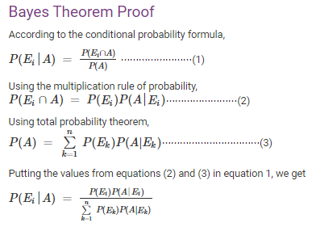
Bayes Theorem Proof

Slide 12
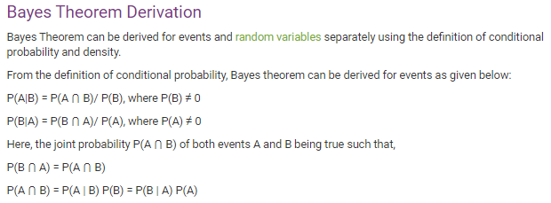
Bayes Theorem Derivation

Slide 13
Why Naive - The Naive Bayes Assumption
The word naive implies that every pair of features in the dataset is independent of each other. All naive Bayes classifiers work on the assumption that the value of a particular feature is independent from the value of any other feature for a given the class.
Naive Bayes classifier assume that the effect of the value of a predictor (x) on a given class (c) is independent of the values of other predictors. This assumption is called class conditional independence.
It’s quite tedious to calculate the set of probabilities for all values again and again. Fortunately, with the naive conditional independence assumption, the conditional probabilities are independent of each other.
In terms of machine learning, we mean to say that the features provided to us are independent and do not affect each other, and this does not happen in real life. The features depend on the occurrence or value of another, which is simply ignored by the Naive Bayes classifier and is hence given the term, “NAIVE”.

Slide 14
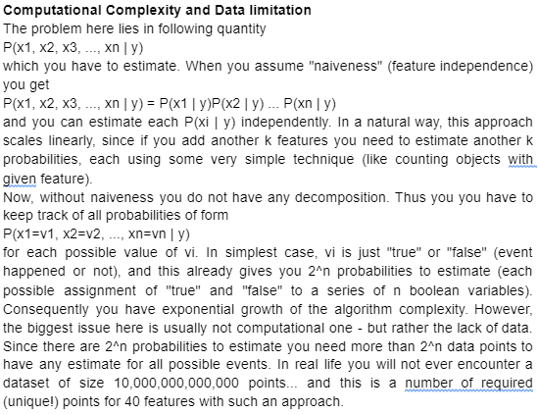

Slide 15
Naive Bayes Classifier
Supervised machine learning algorithms based on the Bayes probability theorem

Slide 16
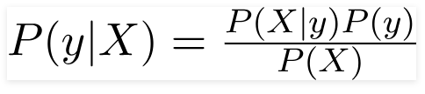

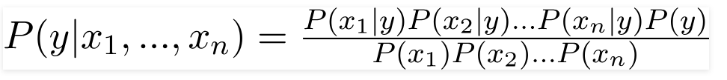


Bayes Theorem
Feature Vector
Expanding the bayes theorem using chain rule
The Denominator remains constant for all the entries in dataset, hence
Class with maximum probability

Slide 17
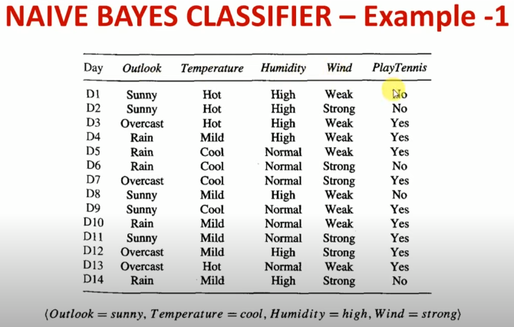

Slide 18
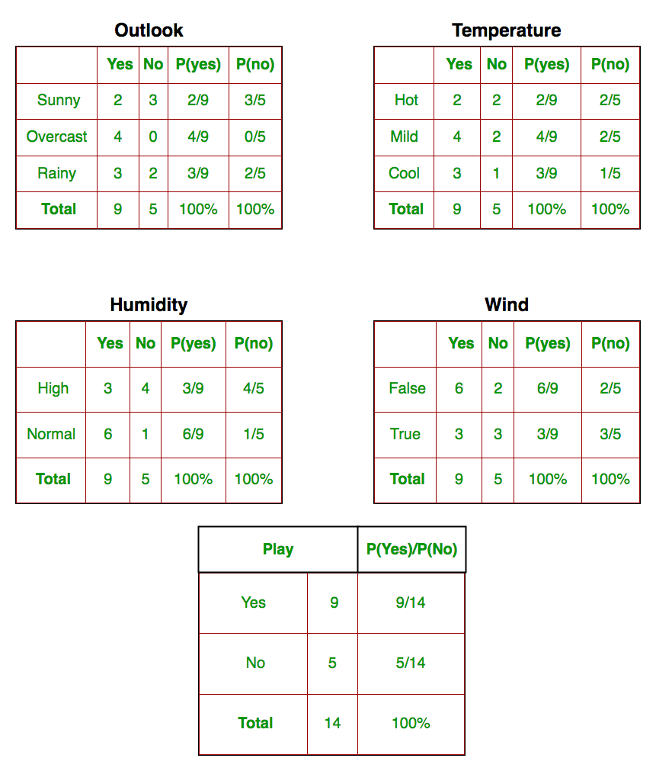

Slide 19
So, in the figure above, we have calculated P(xi | yj) for each xi in X and yj in y manually in the tables 1-4. For example, probability of playing golf given that the temperature is cool, i.e P(temp. = cool | play golf = Yes) = 3/9.
Also, we need to find class probabilities (P(y)) which has been calculated in the table 5. For example, P(play golf = Yes) = 9/14.
So now, we are done with our pre-computations and the classifier is ready!
Let us test it on a new set of features (let us call it today):
today = (Sunny, Hot, Normal, False)

Slide 20
So, probability of playing golf is given by:
and probability to not play golf is given by:
Since, P(today) is common in both probabilities, we can ignore P(today) and find proportional probabilities as:
And
Now, since
These numbers can be converted into a probability by making the sum equal to 1 (normalization):
And
Since; P(Yes/Today) > P(No/Today)
So, the Prediction that Golf will be played is: YES

Slide 21
Types of Naive bayes Classifier
Gaussian The Gaussian Naive Bayes, is based on a continuous distribution and it's suitable for more generic classification tasks. (General use)
In Gaussian Naive Bayes, continuous values associated with each feature are assumed to be distributed according to a Gaussian distribution. A Gaussian distribution is also called Normal distribution. When plotted, it gives a bell shaped curve which is symmetric about the mean of the feature values
Multinomial Multinomial naive Bayes assumes to have feature vector where each element represents the number of times it appears (or, very often, its frequency). Works well on Discrete data, when predicted variable is not binary, but has more categories.
Bernoulli features are independent booleans (binary variables) describing inputs. Like the multinomial model, this model is popular for document classification tasks, where binary term occurrence (i.e. a word occurs in a document or not) features are used rather than term frequencies (i.e. frequency of a word in the document).

Slide 22
Use Cases
Real-time prediction: Because Naive Bayes is fast, it works well at making predictions in real-time.
Multiclass prediction: Naive Bayes works well when there are more than two classes for the output variable.
Text classification: Text classification also includes sub-applications like spam filtering and sentiment analysis. Since Naive Bayes works best with discrete variables, it tends to work well in these applications.
Recommendation systems: Naive Bayes is commonly used alongside other algorithms like Collaborative Filtering to build recommendations systems like Netflix’s recommended for you section, or Amazon’s recommended products, or Spotify’s recommended songs.

Slide 23
Advantages of Naive Bayes
When the assumption of independent predictors holds true, a Naive Bayes classifier performs better as compared to other models. & it will converge quicker than discriminative models like logistic regression.
Naive Bayes requires a small amount of training data to estimate the test data. So the training period takes less time.
Very simple, easy to implement, and fast. It can make probabilistic predictions.
It is highly scalable. It scales linearly with the number of predictor features and data points.
Can be used for both binary and multi-class classification problems.
Handles continuous and discrete data and is not sensitive to irrelevant features.

Slide 24
Disadvantages of Naive Bayes
The main limitation of Naive Bayes is the assumption of independent predictor features. Naive Bayes implicitly assumes that all the attributes are mutually independent. In real life, it’s almost impossible that we get a set of predictors that are completely independent or one another.
If a categorical variable has a category in the test dataset, which was not observed in training dataset, then the model will assign a 0 (zero) probability and will be unable to make a prediction. This is often known as Zero Frequency. To solve this, we can use a smoothing technique. Details on additive smoothing or laplace smoothing can be found here.

Slide 25


